Slide 1


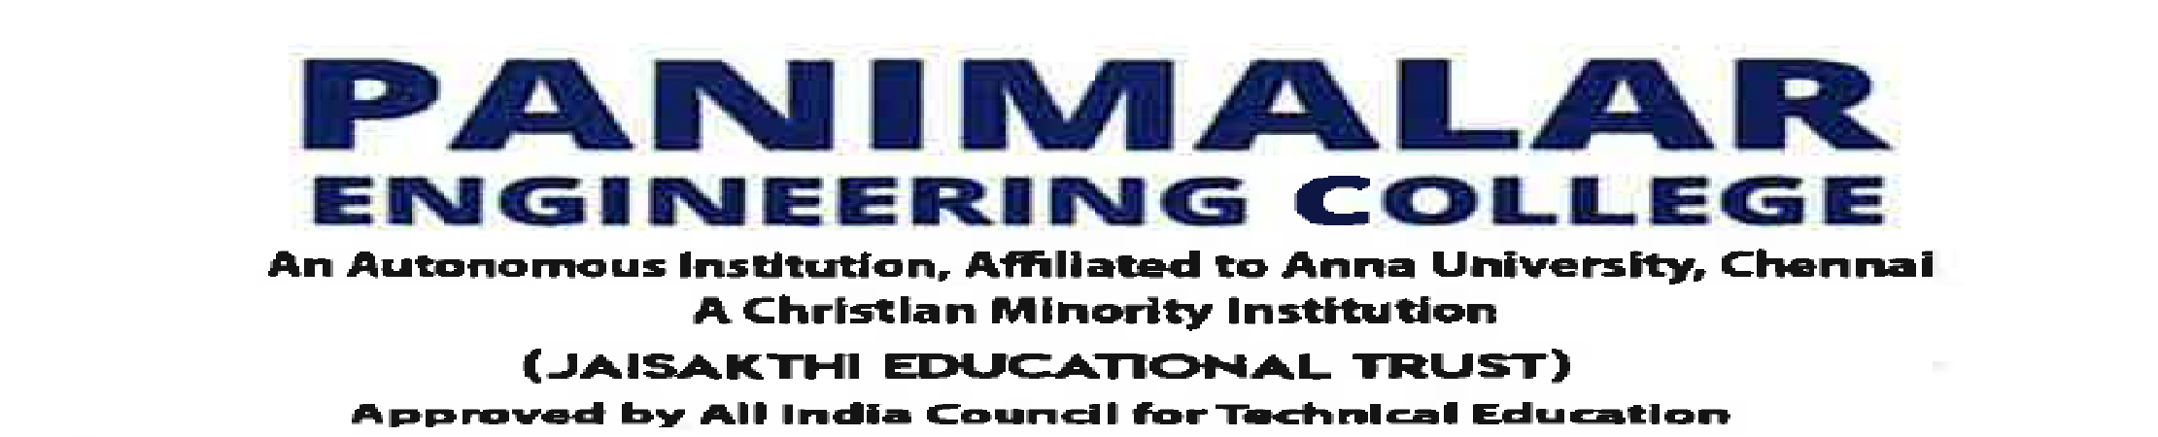
Department of Computer Science and Engineering
Violation Detection and Sustainbility Design of Vehicles using IoT and AI
Abdullah R – 211420104002
Abishek R – 211420104009
Anandha Dinesh J – 211420104016
Dr.L.Jabasheela, Professor & HOD of CSE Dept.
Dr.G.Senthilkumar, Professor.

Slide 2
Problem Statement:
Currently biggest back-set faced by our country is pollution especially in places like Delhi where air toxicity is well beyond bars.
More than 45% of this pollution are by products of vehicular emissions given by official stats of our country.
Given the major component in GHG being CO2, CO and NH3 our project mainly focus on effectively controlling the emission of these toxic gases from vehicles.
Our product also addresses various violations performed by the driver and fine them accordingly.

Slide 3
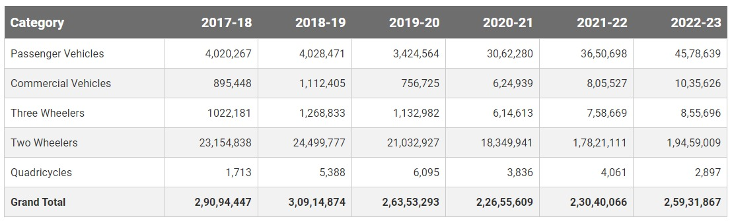
ANNUAL PRODUCTION INDIAN CAR MANUFACTURING UNIT

Slide 4
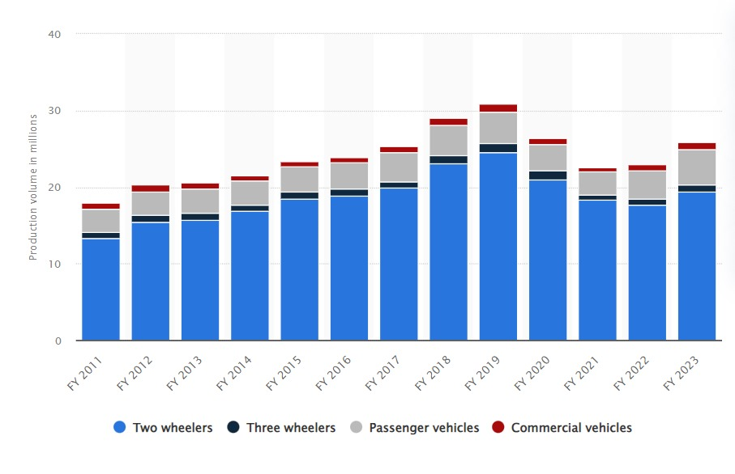
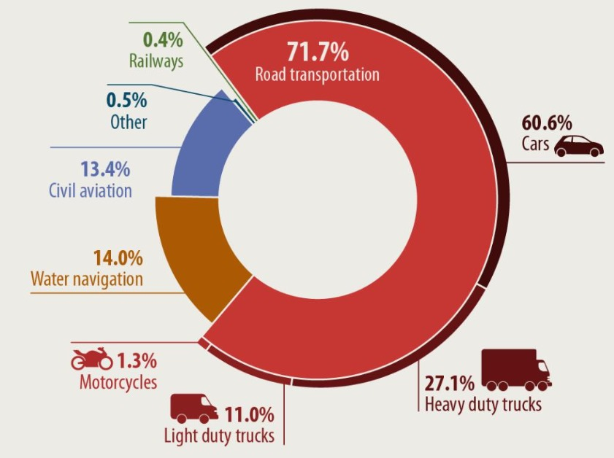
GHG EMISSION STATS INDIA 2021

Slide 5
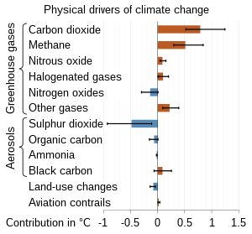
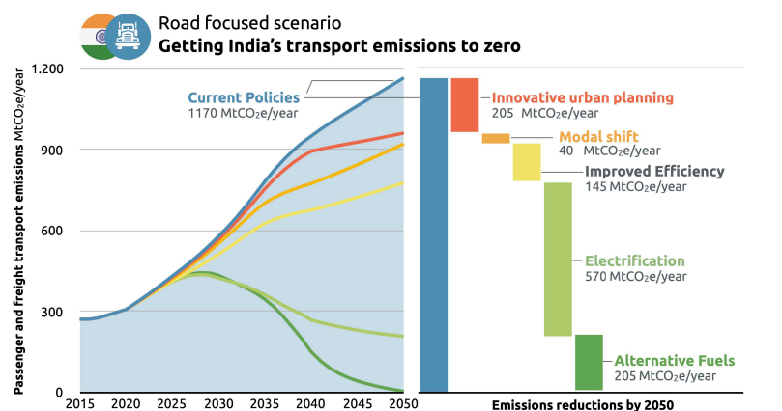
Emission Control Policy Projection - Indian transport Sector
COMPOSITION OF GHG 2021

Slide 6
CONSTITUTIONAL LAWS OF INDIAN GOVERNMENT
Article 51A(g): Added by the 42nd Amendment, this provision emphasizes the fundamental duty of every citizen of India to protect and improve the natural environment including forests, lakes, rivers, and wildlife.
The Air (Prevention and Control of Pollution) Act, 1981: This law aims to prevent, control, and abate air pollution. It grants authority to central and state pollution control boards to take actions against air pollution sources.
The Motor Vehicles Act, 1988: While not a constitutional provision, this act governs various aspects of road transport, including vehicle registration, licensing, and traffic rules. It empowers the central and state governments to prescribe standards for vehicular emissions and noise.
The Central Motor Vehicles Rules, 1989: These rules, made under the Motor Vehicles Act, contain provisions related to vehicle standards, including emission norms for various types of vehicles.
Bharat Stage Emission Standards (BSES): India has adopted emission standards known as Bharat Stage norms, similar to the Euro emission standards used in Europe. These standards set limits on the permissible levels of pollutants that can be emitted from vehicles. They are notified by the Ministry of Road Transport and Highways.
The Environment (Protection) Act, 1986: While not specific to vehicles, this act empowers the central government to take measures to prevent and control environmental pollution. Under this act, the government has notified emission standards for industries and vehicles to control pollution.

Slide 7
Abstract:
The pollution control standard set by our govt. calls for 1500 PPM of CO2 per vehicle but due to unused or prolonged usage without service may lead to emissions exceeding the norms.
By Implementing IOT and AI via green Telematics we can track the emission rate of vehicles and intimate IRDAI there by the user will be fined if their vehicle crosses the threshold which will reflect in their yearly insurance premium.
Our product is named Vehicure.
We also address violations like over-speeding and intimate accidents to nearby Hospitals via our application.
And if the driver is Drowsy/sleepy or using mobile devices while driving, we installed buzzer to wake him up by detecting the drowsiness accurately through Image Processing.

Slide 8
Research Survey:
IoT Based Health Monitoring System with LoRa Communication Technology [1] present an IoT based health monitoring system using the MySignals development shield for Arduino Uno. Evaluating the performances and effectiveness of the sensors and wireless platform devices are also the aim of the project. My Signals enables multiple sensors such as temperature, ECG, oxygen saturation and pulse rate to gather the physical data.
“Health Monitoring System using Raspberry Pi and IOT”E. N. GANESH INDIA 2019 [2]Proposes the healthcare monitoring which is implemented to check the temperature, blood pressure, heart beat, oxygen and position of the patient. The Zig Bee mesh protocol is used where the patient 24-hour care records is being monitored.
Viability of Azure IoT Hub for Processing High Velocity Large Scale IoT Data[3] Study suggests significant variation in latency occurs when the system exceeds IoT Hub specifications. The results are predictable and well-behaved for a well-engineered system and can meet soft real-time deadlines.

Slide 9
Green Telematics
Proposed Solution:
The science of telecommunications and informatics also referred to as Wireless Access of Vehicular Environment (WAVE) applied in wireless technologies and computational systems.
We are going to Implement the following sensors to capture the exhaust quality from the vehicles,
MQ-7 sensor(CO) and SGP30(CO2, ammonia and H2S.
The data captured by these sensors are stored in Telematics Cloud Server like Azure and can be accessed by our web application.
Similarly we use accelerometer, vibration and gyroscopic sensor to monitor vehicle’s speed and stability

Slide 10
Azure also offers Dynamic Threshold in-metrics alert where our data will be analysed by a well trained Machine Learning Algorithm to find out the presence of any anomaly in the serial sensor output data.
It also allows dynamic setup of alert threshold.
So when the pollutants PPM exceeds their respective safe limit then an alert message will be triggered to the user’s phone using Twilio SMS API Service.
But in case of any violation of rules like over-speeding he will directly be charged accordingly by our system.
Also, the user’s data will be updated to IRDAI website which will be assigned to the insurance agencies to reflect fine on the respective person in their annual insurance due in case the problem remains uncorrected for a prolonged time.

Slide 11
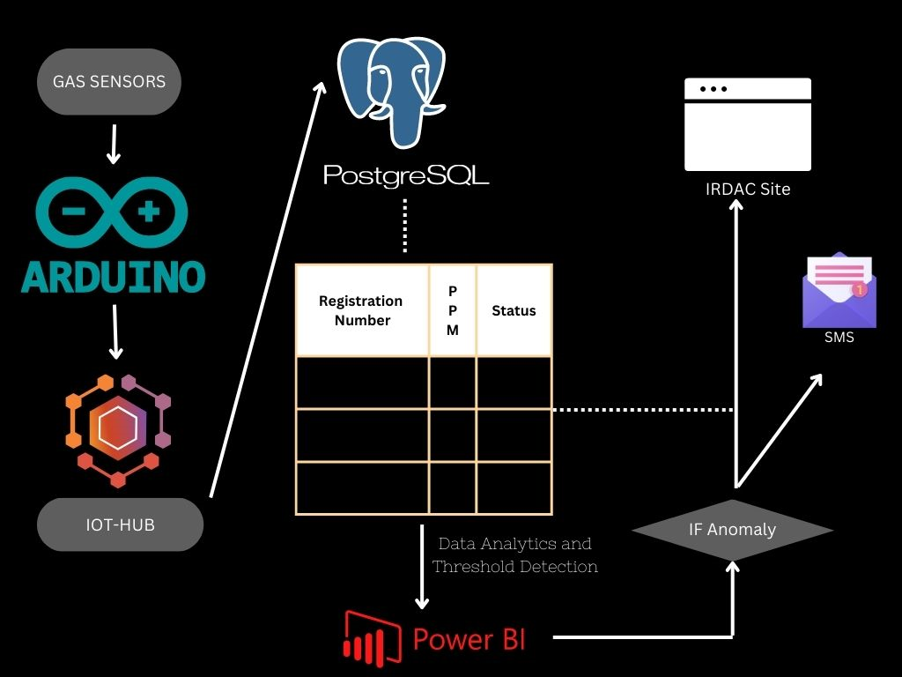

Slide 12
Distraction Detection:
Our system has an installed camera module which is programmed to Detect Drowsiness via Computer Vision Techniques.
We have also included the factor of detecting whether the user is using mobile devices while driving their vehicle and alert them accordingly.
Once the user is classified to be asleep by analysing his eye patterns per 50 frame then the installed buzzer will start ringing continuously to wake up the driver.
Also, if the driver is distracted while driving, like using mobile phones then it will also be classified under violation.

Slide 13
TECHNOLOGY USED FOR FUTURE SCOPE:
GPS technology and on-board diagnostics (OBD) to plot the asset's movements on a computerized map.
A telematics engineer will be working in Linux environments, either to administer the device or to use it to automate processes. Thus, Bash is a language that comes with all Unix based systems. It is an excellent scripting language for automating tasks
The Telematics Control Unit (TCU), which is the central hardware module of the telematics device, has communication interfaces with the in-vehicle network (CAN Bus) and the backend cloud server( GPRS) . TCU collects the crucial vehicle data such as diagnostics data, real time location, and speed of the vehicle (through different interfaces) and sends them to the cloud server over wireless network such as GPRS/cellular/LTE , in a specific packaged format.

Slide 14
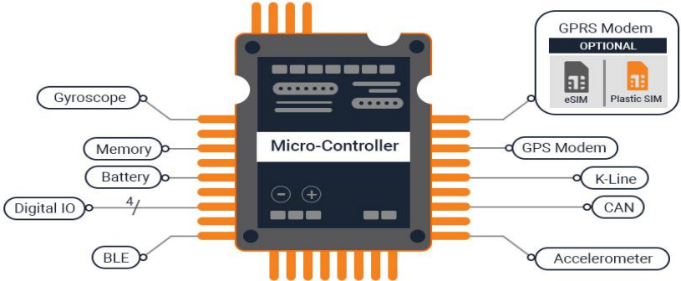
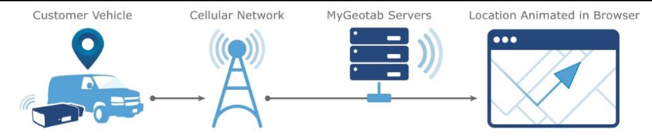
MyGeoTab Server – Live Vehicular Monitoring Service.

Slide 15
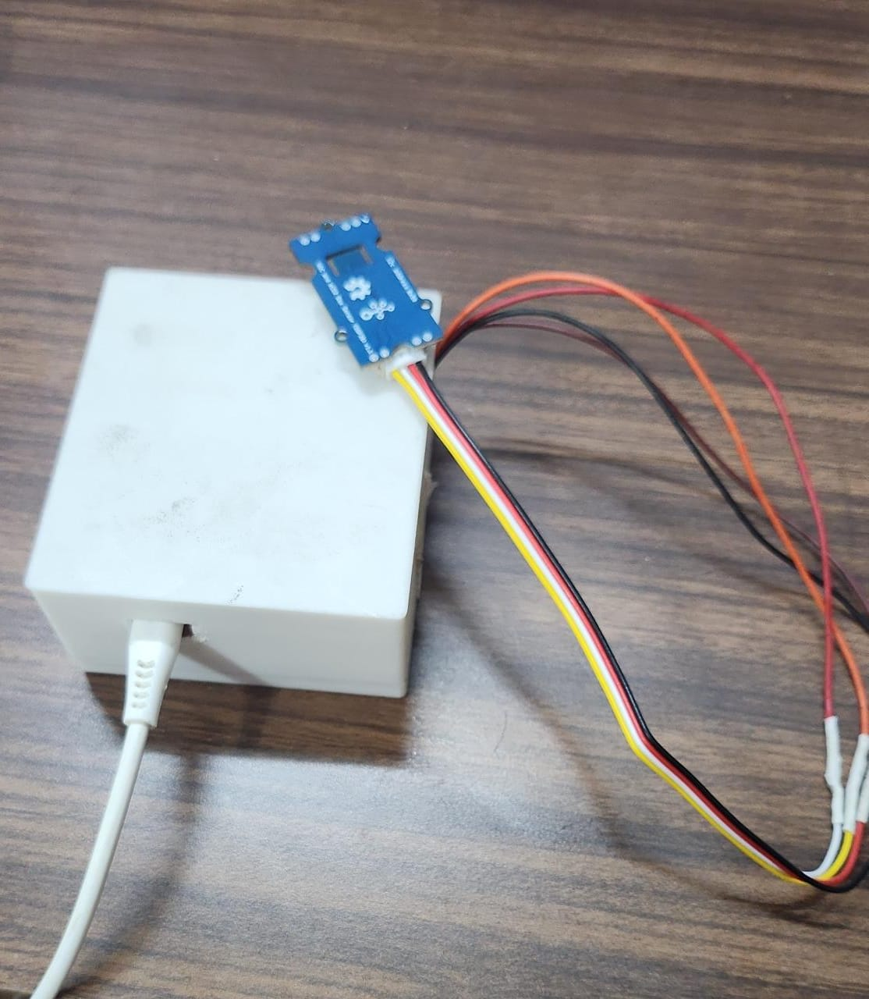
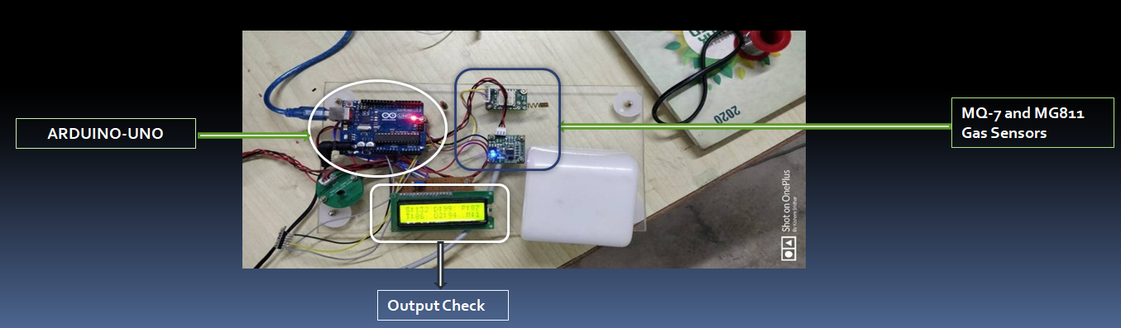
Hardware - Green Telematics

Slide 16
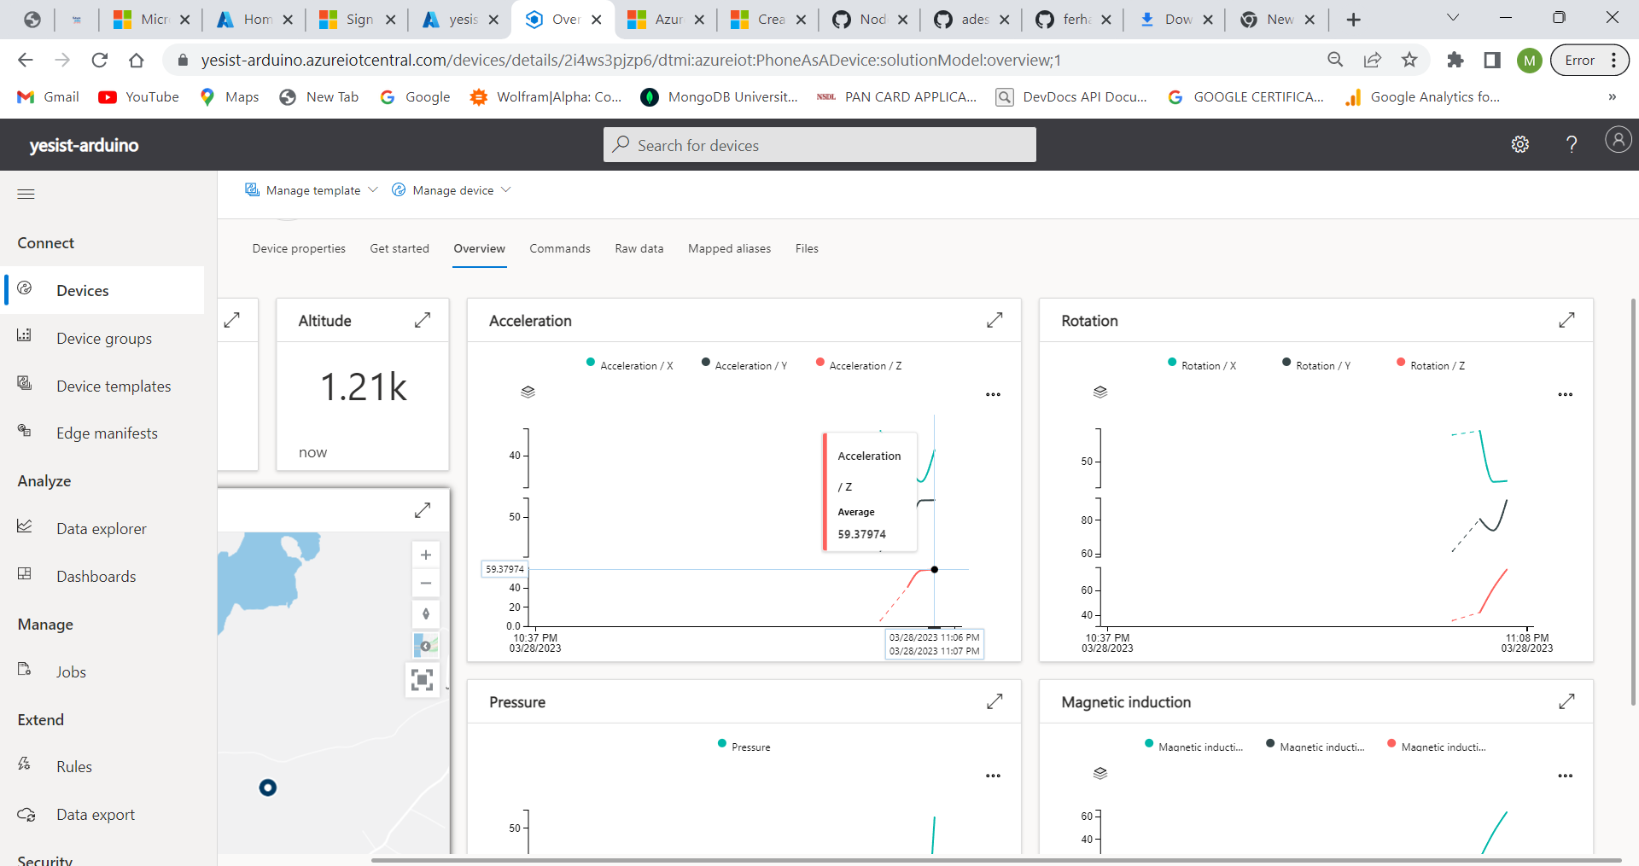
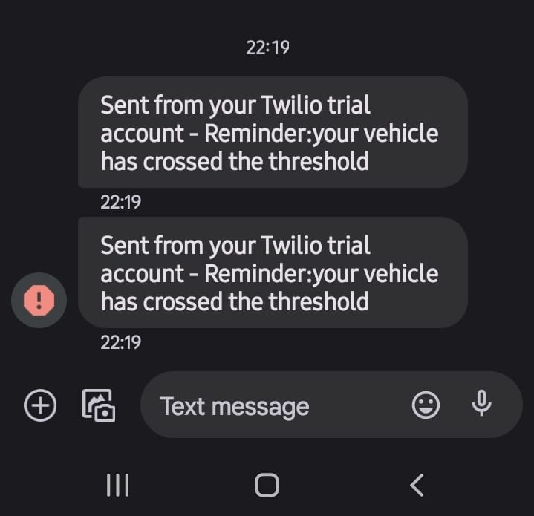
Speed Projection IOT Hub
Twilio SMS API

Slide 17
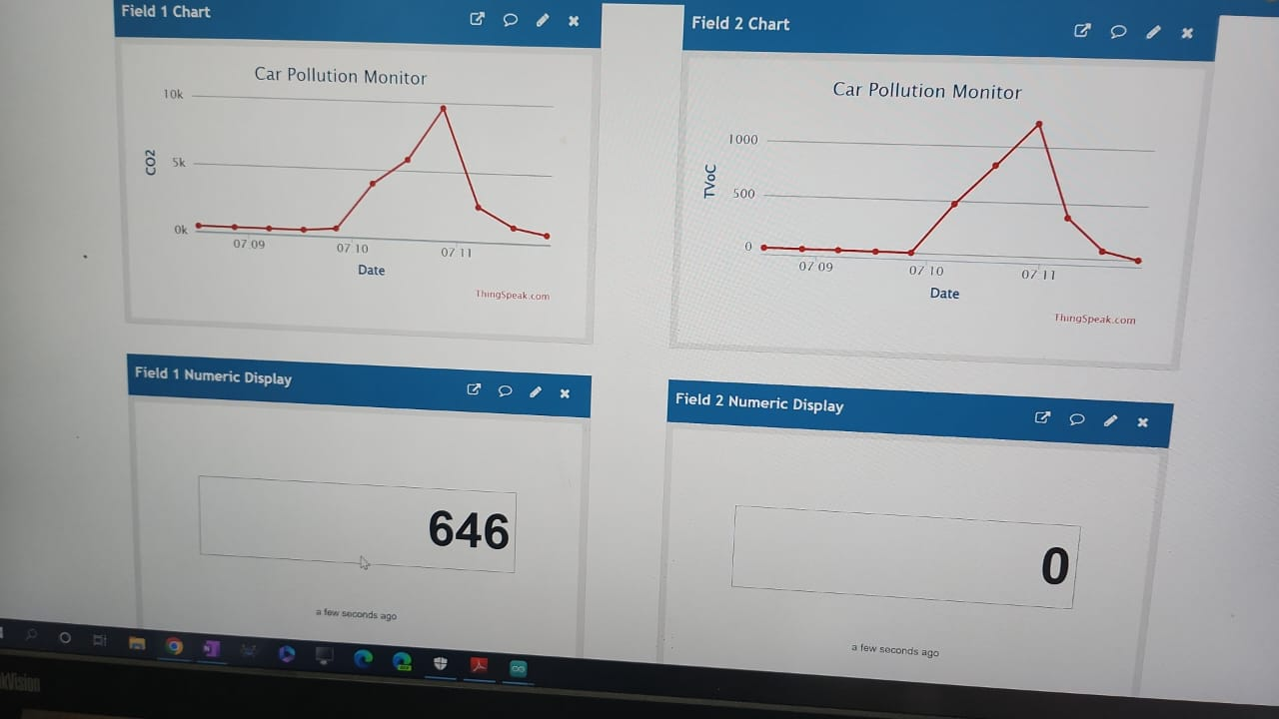
Cloud Infranstructure (Thingspeak)

Slide 18
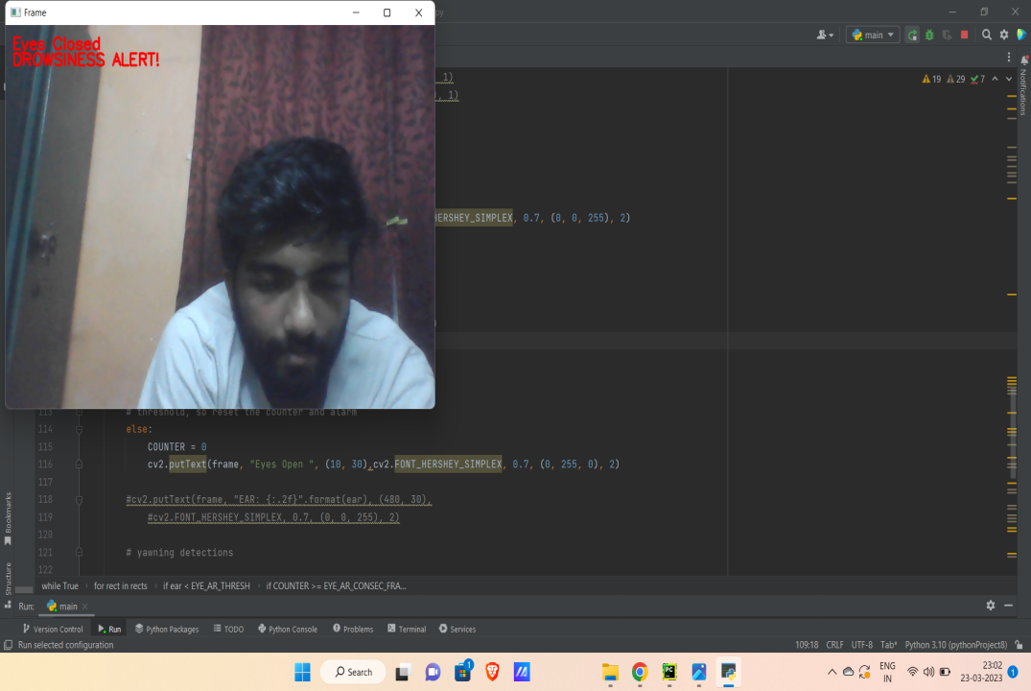
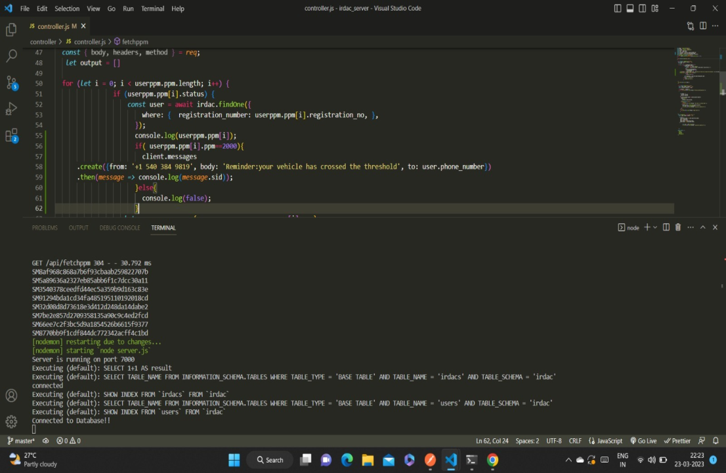
Drowsiness Detection and Alert System
IRDAI Site and DB Setup

Slide 19
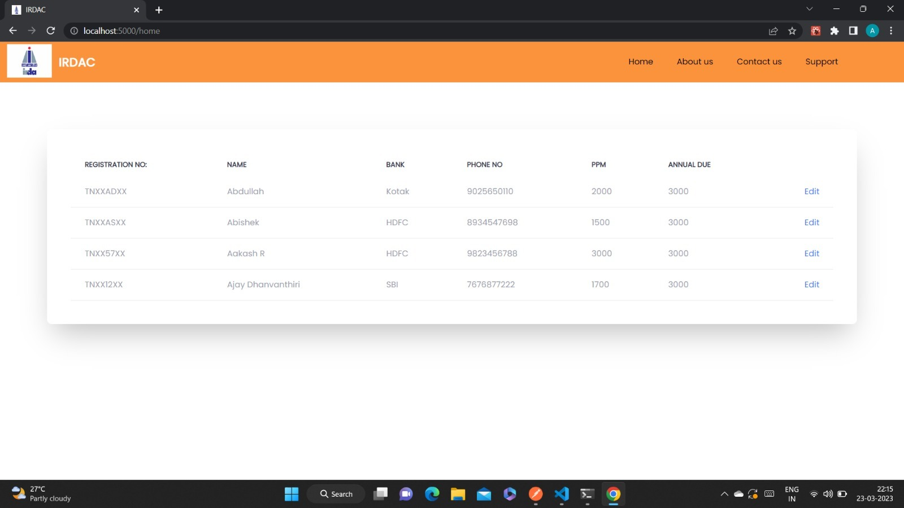
IRDAI Sample Site

Slide 20
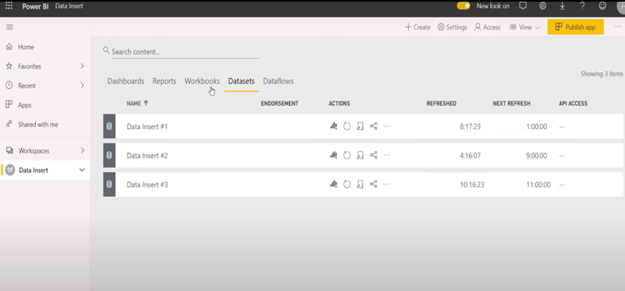
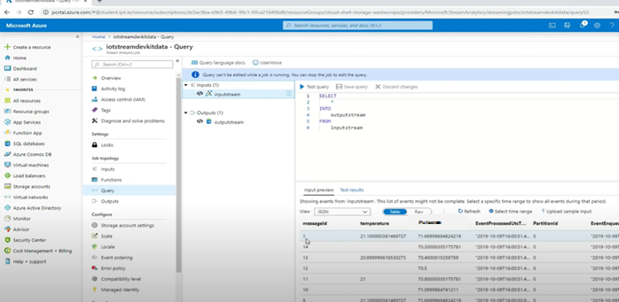
Data Write-back to SQL DB by Power BI using Power Query
IOT-hub Sensor data storage in azure PostgreSQL DB
These will be integrated to our Hardware model

Slide 21
Advantages
Self Validation.
The Telematic device with implementation of accelerometer will automatically detect if the driver
violates the traffic signal or not so it’ll make there’ll be decreased amount of accidents that’ll avoid collateral damages to the government.
Also prevents accidents due to dozing off while driving high speeds.
Significant decrease in Green House Gas Emission by Vehicles.
Disadvantages
Maintenance of the sensor and controller by periodic service is required.
Plan has to be initiated by the government in order to be customized to privately manufacturing vehicles.
Processors like Sony Spresense will cost a lot compared to Arduino UNO.

Slide 22
Cost of Implementation:
There is a one time installation cost which is around Rs 7000 to RS 8000,in the future all vehicle manufacturers will add this device while manufacturing the vehicles
There will be a additional cost of Rs 200-Rs 500 per year this is for all time tracking ,location services , and health services So by our
Calculation :-
cost for one time installation : Rs.8000 , cost of Azure Cloud Service(total): Rs.8000
Cost for services per year: Rs.300.

Slide 23
References:
[1] Tan, Lu, and Neng Wang. "Future internet: Theinternet of things." 2020 3rd International Conference on Advanced Computer Theory and Engineering (ICACTE).Vol. 5.IEEE, 2020.
[2] K. Natarajan , B. Prasath , P. Kokila , ”Smart Health Care System Using Internet of Things” ,Journal of Network Communications and Emerging Technologies (JNCET), 2022, JNCET.
[3]B. Posey, A. Deer , W. Gorman, V. July , N. Kanhere, D. Speck , B. Wilson, and A. Apon. 2023. On-Demand Urgent High Performance Computing Utilizing the Microsoft Cloud Platform. In 2019 IEEE/ACM HPC for Urgent Decision Making (UrgentHPC) . IEEE, 13--23. https://doi.org/10.1109/UrgentHPC49580.2023.00008
[4]Nicole Berdy. 2021. IoT Hub throttling and you. https://azure.microsoft.com/en-us/blog/iot-hub-throttling-and-you. https://azure.microsoft.com/en-us/blog/iot-hub-throttling-and-you

Slide 24
Thank You

